Slide 1
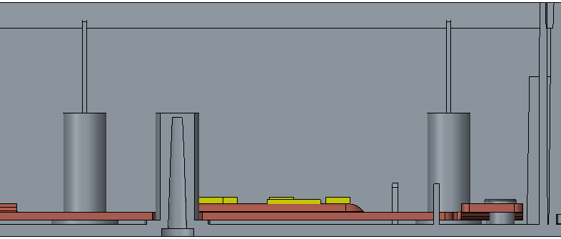


Current
T=2mm
1mm

Slide 2
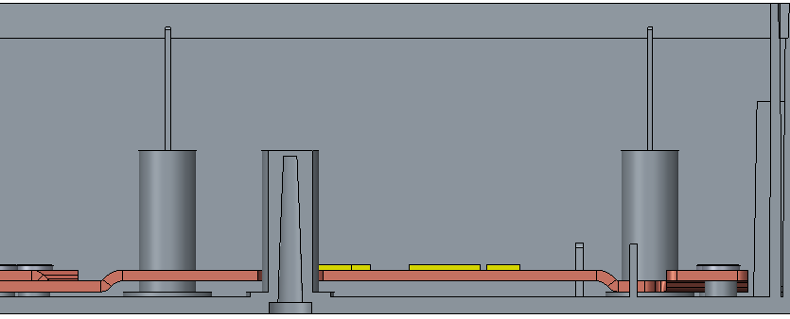


Updated
Increase the bump, T=2mm
3mm

Slide 3
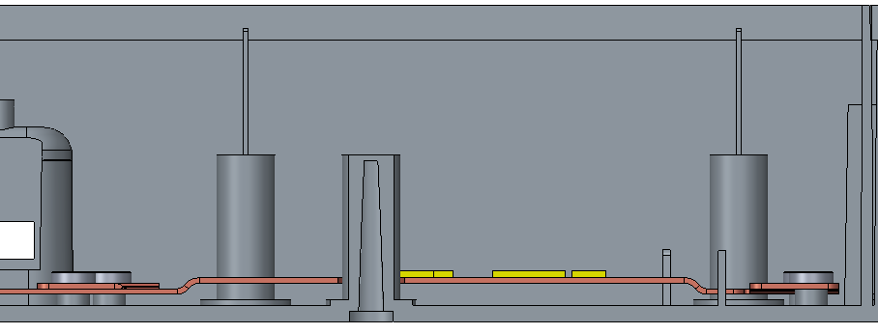


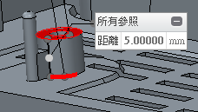
Updated
Increase the bump, T=1mm
4mm
Add 1mm on screw hole

